Slide 1
Study Program
Reducing obstructive sleep apnea after OGS surgery by evaluating the cephalometric parameters : single medical center study
Professor: Chiou-Shann Fuh
Presenter: Yao-Jen Chang
E-mail: D12922006@ntu.edu.tw
Phone: 0935311269

Slide 2
Introduction
1. Obstructive Sleep Apnea
2. Orthognathic surgery
3. Cephalometric image

Slide 3
Introduction
Obstructive sleep apnea (OSA) occurs when there are recurrent episodes of upper airway collapse and obstruction during sleep associated with arousals with or without oxygen desaturations.
The oropharynx in the back of the throat collapses during OSA events to cause arousal or oxygen desaturation or both resulting in fragmented sleep.

Slide 4
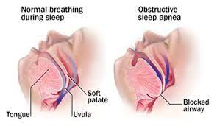
Obstructive Sleep Apnea

Slide 5
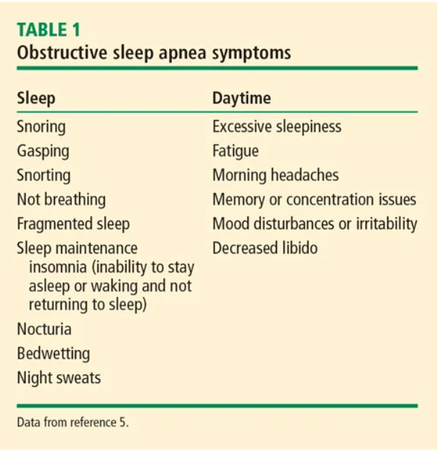

Slide 6
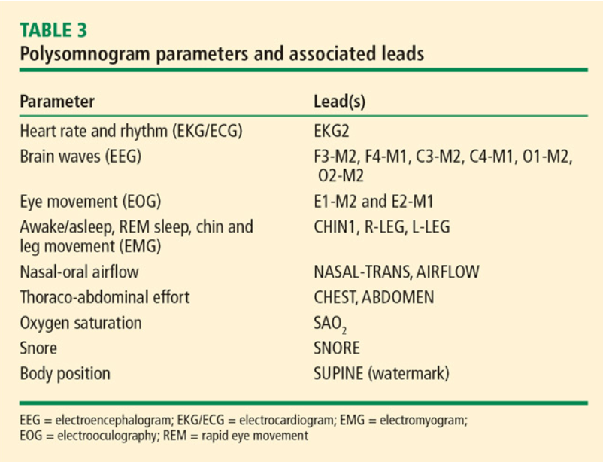
Diagnostic criteria

Slide 7
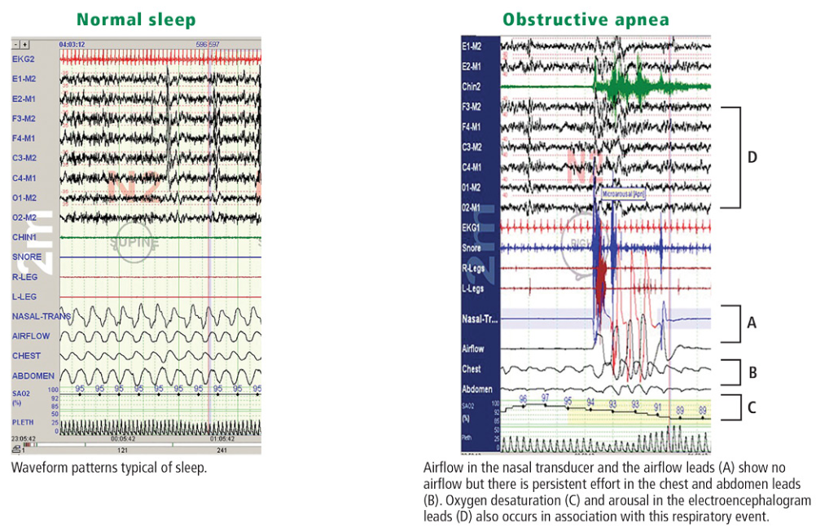
Polysomnogram (PSG)

Slide 8
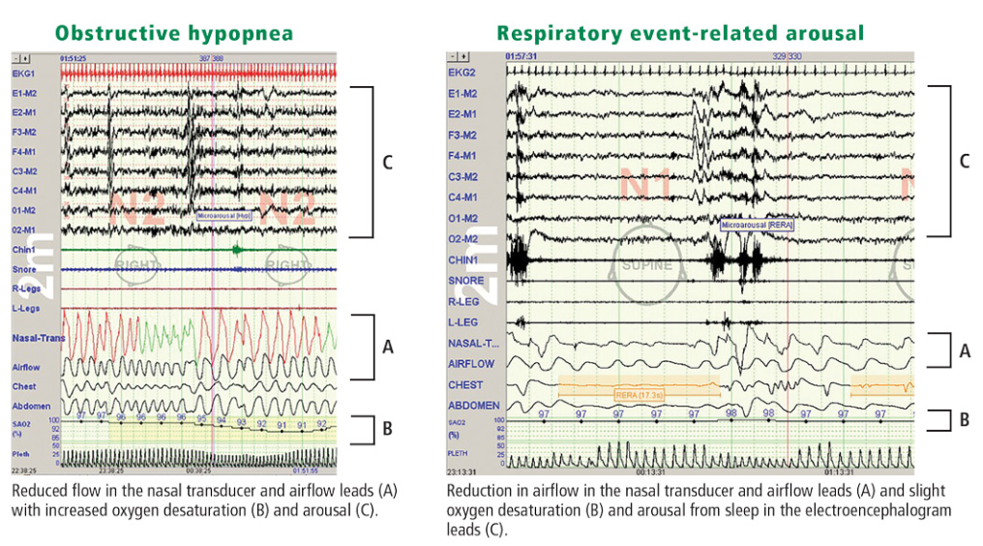
Polysomnogram (PSG)

Slide 9
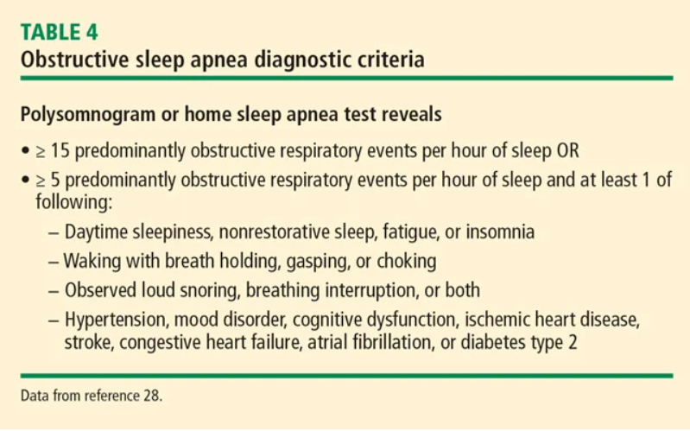
Diagnostic criteria

Slide 10
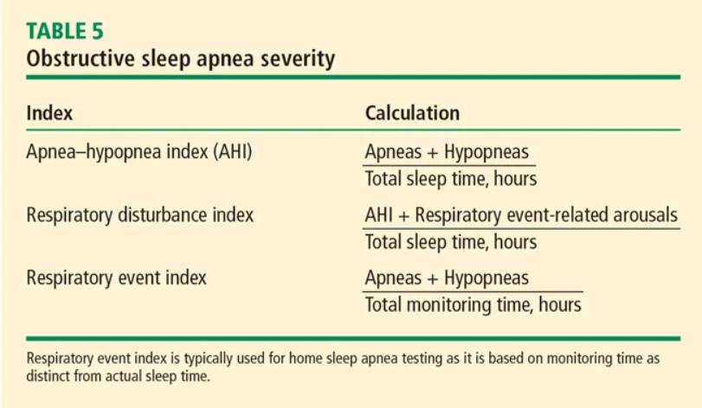
For any of the three indexes, a value 5 to 14.9 is considered mild, 15 to 29.9 is considered moderate, and 30 or greater is considered severe.

Slide 11
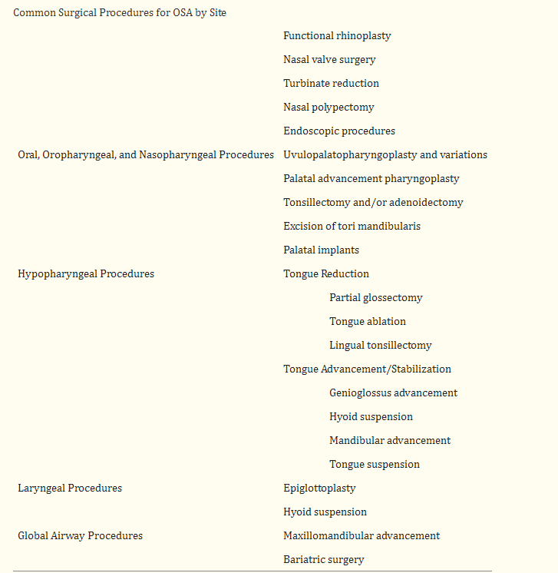

Slide 12
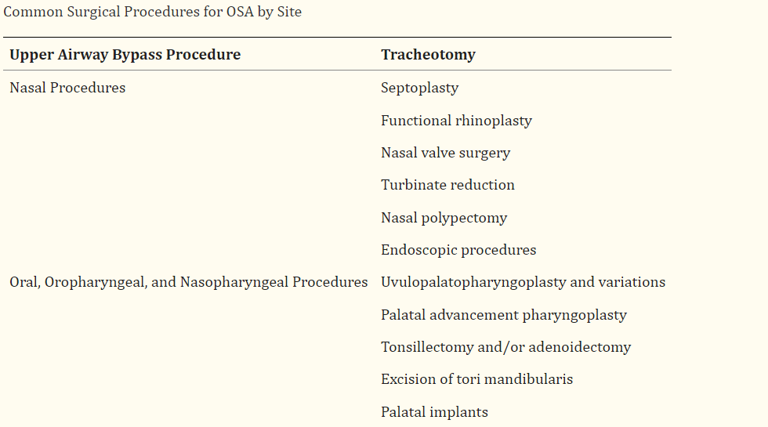
Surgical Intervention

Slide 13
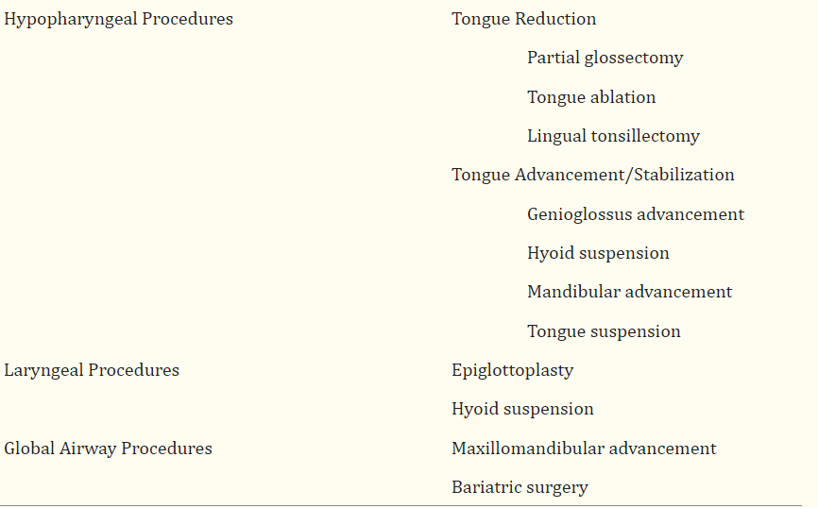
Surgical Intervention

Slide 14
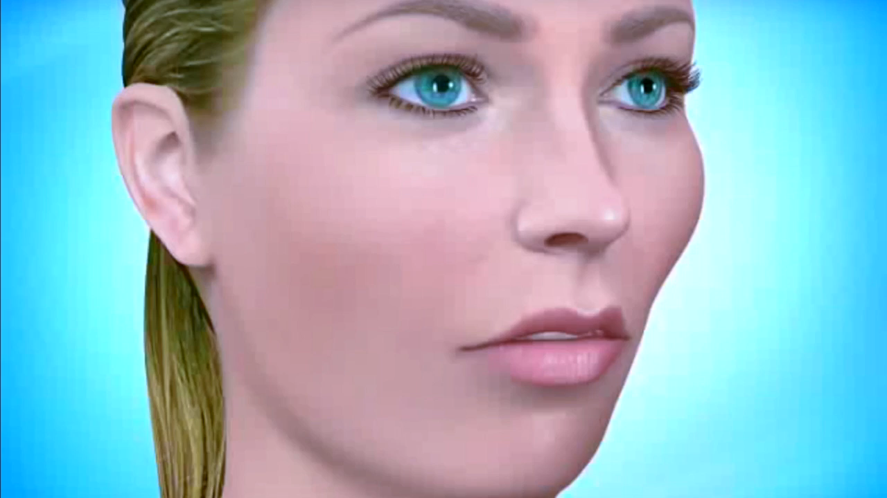
Orthognathic surgery

Slide 15
Orthognathic surgery?
Surgery that helps align your upper jaw (maxilla) and lower jaw (mandible). If your jaws don’t line up, it can affect your bite and make it hard for you to eat and speak.

Slide 16
Jaw problems caused by injuries or medical conditions?
Facial fractures. The term jaw fracture can refer to your lower jaw (mandible) or your upper jaw (maxilla).
Cysts and tumors.
Obstructive sleep apnea (OSA).OSA is treated with jaw surgery called maxillomandibular advancement (MMA).
Temporal mandibular joint disorders (TMJ).
Growth disturbances.

Slide 17

Surgery Simulation

Slide 18
AI Face Reshaping
https://www.perfectcorp.com/business/products/face-reshaping

Slide 19
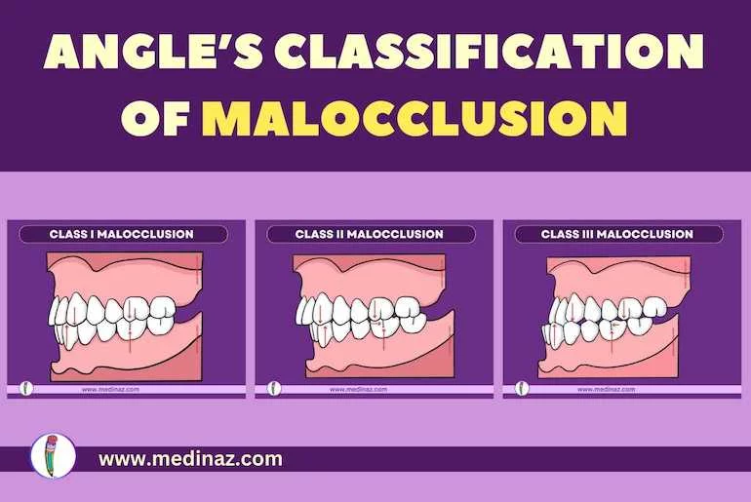

Slide 20

OGS for angel class III

Slide 21
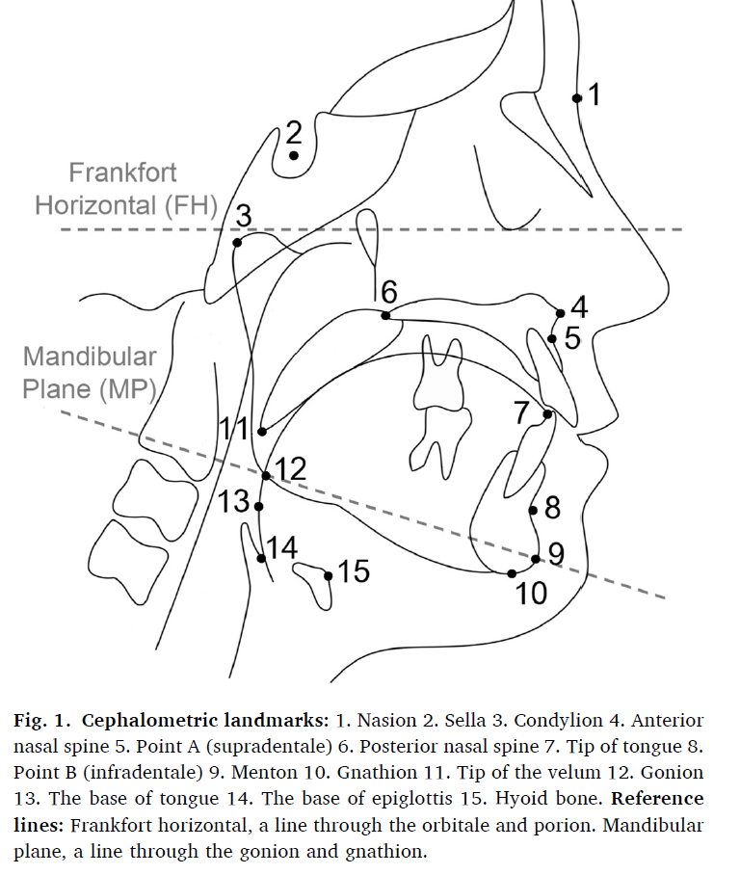
Lateral cephalography

Slide 22
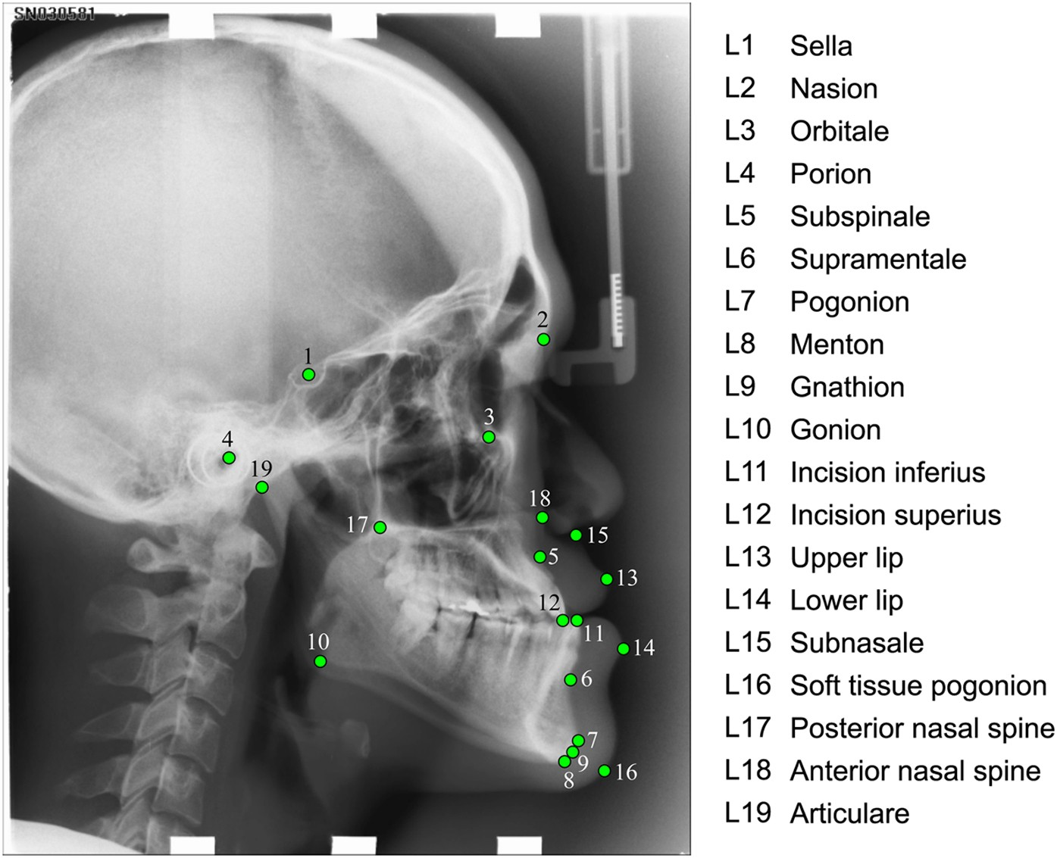

Slide 23
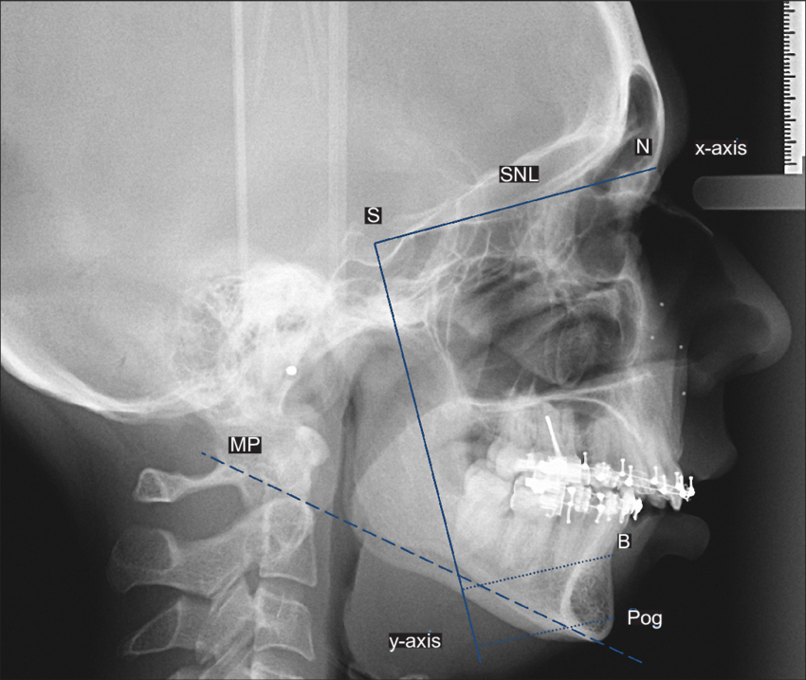

Slide 24
Methods
Participants and study design
Retrospective study was conducted in the Sleep Disorder Department of Shin Kong Hospital, from March 2018 to 2023
The test group consisted of 30 participants with OSA diagnoses based on overnight polysomnography

Slide 25
Methods
Inclusion criteria
  Patients with OSA were as follows:
  Asian patients aged 18–80 years
  Apnea-Hypopnea Index (AHI) ≥15 events per hour (Moderate)
  The willingness of the patients to participate

Slide 26
Exclusion criteria:
  Body mass index (BMI) ≥30
  Prominent nasal or septal deviation
  Maxillofacial deformities
  Severe teeth malocclusion
  Adenotonsillar enlargement (Brodsky grade III and IV)

Slide 27
Cephalometric landmarks
TL, tongue length; H-PH, the distance between the hyoid bone and the posterior pharyngeal wall; H-PNS, the distance between the hyoid bone and the posterior nasal spine; H-MP, the distance between the hyoid bone and the mandibular plane; SPAS, superior posterior airway space; LPAS, lower posterior airway space; ML, mid-face length; RL, ramus length; SNA, the angle between sella, nasion, A point; SNB, the angle between sella, nasion, B point; ANB, the angle between A point, nasion, B point; MP, the angle between the mandibular plane and the line passing from the nasion to the sella; GA, gonial angle.

Slide 28
Results
Patients with OSA
  Mandibular ramus length was significantly bigger (p = 0.02), and mandibular plane made a greater angle with the line passing through the nasion and sella (p < 0.001).
  Retro-positioned mandible (p < 0.001)
  Hyoid bone was placed inferiorly (p < 0.001)
  Elongated tongue (p < 0.001)
  Longer soft palate (p < 0.001)

Slide 29
TEST
Method:
  Reducing obstructive sleep apnea after OGS surgery
Steps:
  By evaluating the cephalometric parameters from single medical center
Result:
  Apply these significant data in doing simulation to reduce OSA after surgery

